Slide 1


POSHAN SHAKTI
A web-based nutrition tracking and donation management system

Slide 2

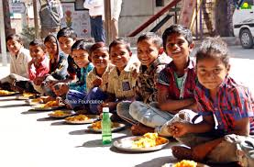
INTRODUCTION
Malnutrition is a major issue among underprivileged children.
The Mid-Day Meal scheme aims to provide nutritious food to improve children’s health and school attendance.
Many NGOs and schools face challenges in tracking meal nutrition and managing.
There is a lack of transparency in donation distribution and utilization.
Poshan Shakti is a web-based platform designed to digitally monitor meal nutrition.
The system allows NGOs to enter meal details and automatically calculate nutritional values such as calories and protein.

Slide 3

PROBLEM STATEMENT
Lack of proper monitoring of nutritional quality in mid-day meals for underprivileged children.
Absence of a centralised digital system for NGO’s to track meal data and food shortages.
Lack of transparency and efficient management in food and monetary donations.
Poor coordination between NGO’s ,donors, and volunteers.

Slide 4
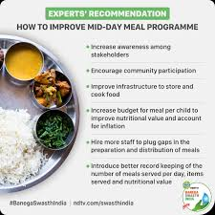
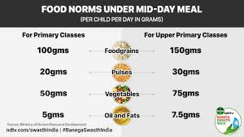
OBJECTIVES
To develop a web-based system for tracking the nutritional quality of Mid-Day Meals.
To help NGOs record daily meal details and number of children served.
To automatically calculate basic nutritional values such as calories and protein.
To identify nutritional gaps in meal plans.
To provide a donation platform for contributing food items or monetary support.

Slide 5


Tech stack required
Frontend: HTML,CSS,,Bootstrap, JavaScript
Backend: java
Database: Mysql
Server and tools: Apache Tomcat ,VS code, JDK

Slide 6
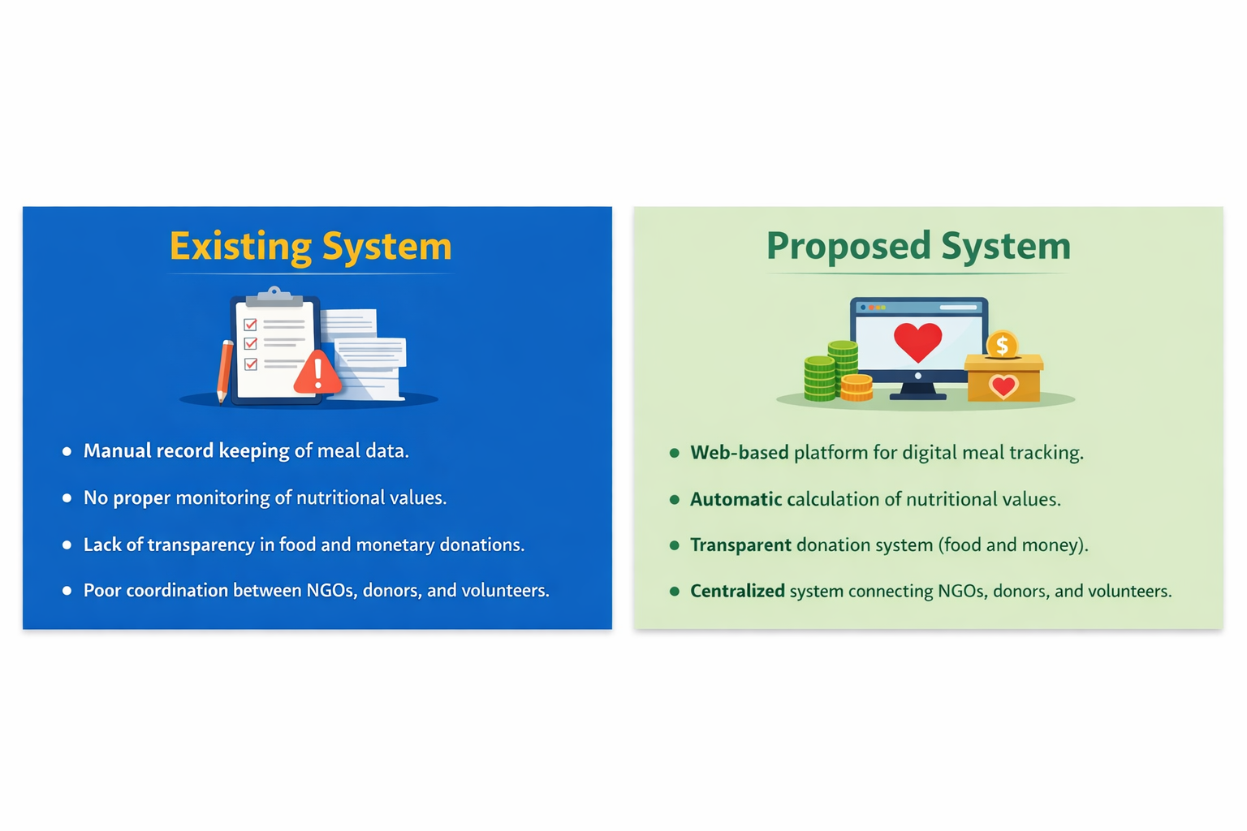
Existing vs proposed system

